Slide 1
Introduction to Analysis of Variance

Slide 2
Analysis of Variance (ANOVA) is useful for a variety of techniques
Comparing multiple means
Regression
Various designed experiments that account for multiple factors and potential interactions of those factors

Slide 3
How ANOVA works
Divide the variance between group means (sometimes called “between”) by the overall pooled variance of the data (sometimes called the “within”)
If the difference between means is significantly higher than the pooled variance of all the data conclude the means are not equal

Slide 4
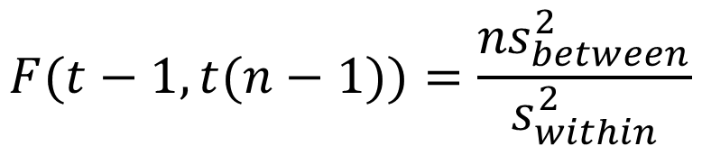
One way ANOVA (to compare means when there are more than two groups)
H₀: μ₁ = μ₂ = μ₃ …= μ_{t}
H_{A}: At least one mean is not equal
$$F(t−1, t(n−1))=\frac{{ns}_{between}^{2}}{s_{within}^{2}}$$
S_{between} standard deviation between means
S_{within} standard deviation within groups
n is the sample size
t is the number of groups (treatments)

Slide 5
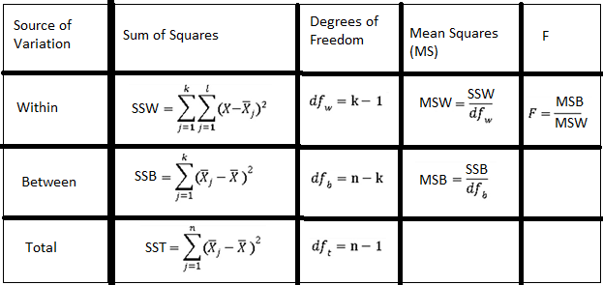
ANOVA table (background info)
ANOVA tables, detailing steps in the calculating the F statistic, are often shown in software output

Slide 6
Note: t-test vs ANOVA
The ANOVA will result in the same p-value as a t-test for two means (the F and t distributions are mathematically related, F is a ratio of two chi-squares, the chi-square is the square of normal)
Rule of parsimony (it is acknowledged, but poorly followed in practice)
If t-tests are considered easier to explain and you have the option of using a t-test or an ANOVA, use the t-test by rule of parsimony
However, if ANOVA works for two means or any number of means larger than two, some might say always use ANOVA by rule of parsimony
If you are testing more than two means, you must use ANOVA

Slide 7
Common tests with ANOVA for means
Levene’s test for equality of variances
Pairwise comparison of means (there’s a difference between means, the next logical question is which means differ from each other)
If multiple t-test are used, comparison-wise error rate are held to 0.05 for each test, but experimental error rates increase!
Experiment-wise error rates = 1 – (1 – α)^{t}
Pairwise comparison techniques: Fisher LSD (no experiment-wise control), Tukey (ensures experiment-wise 0.05 alpha rate), Duncan multiple range test, is a compromise of the LSD and Tukey approaches

Slide 8
Notes on Multiple Mean Comparison
LSD, Duncan, Tukey are post hoc tests of means
If looking for a particular effect in means, a priori contrasts can be used that are more powerful than post hoc tests; however, these require a specific comparison among means (we can’t just ask the general question, which means are different?)
There are other approaches, for example, Dunnet’s test only tests all means against one mean in the group, Bonferroni (α/n), etc.
Personal opinion: a post hoc test like Duncan’s, fits the majority of business situations

Slide 9
Example: New Micro Treatment
A study was conduct to test the impact of a new treatment on its effectiveness reducing micro levels in raw poultry. 45 products were randomly sampled and one of three treatments was randomly applied: No treatment (a control), water with chlorine added (chlorine), and a new food-safe anti-microbial treatment (newtrt)
Results are found in “new micro treatment.txt”
Use SAS to test:
H₀: μ_{CONTROL} = μ_{CHLORINE} = μ_{NEWTRT}
H_{A}: At least one mean is not equal

Slide 10
R Code
apc<-read.csv("T:/Matt.Brown/new micro treatment.csv",header=TRUE)
head(apc)
apc$trt<-as.factor(apc$trt)
fit<-aov(log10APC~trt,data=apc)
summary(fit)
TukeyHSD(fit,"trt")
aggregate(log10APC~trt, data = apc, FUN = mean)
#install.packages("agricolae") #only needs to be ran once
#library(agricolae)
#dun<-duncan.test(fit, "trt", group = TRUE)
#print(dun)

Slide 11


Results
ANOVA table
The p-value is well less than 0.05, we reject the null hypothesis and conclude at least one of the means is different from the other two.
In “statistics speak”, we can also say the treatment (trt) effect was significant.
The next logical question is how are the means different from each other?

Slide 12
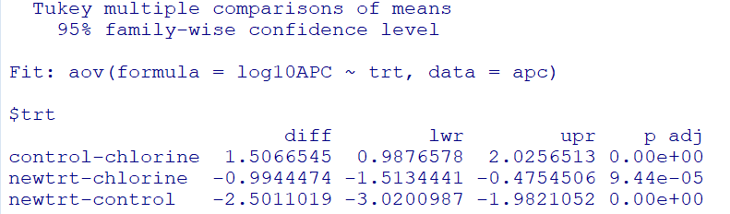


Results (continued)
Tukey multiple mean comparison output
Each pair of means is significantly different from each other.
The means are:

Slide 13
SAS Code
proc glm data=apc;
class trt;
model log10APC=trt;
quit;
proc glm data=apc;
class trt;
model log10APC=trt;
means trt / duncan tukey hovtest=levene;
quit;

Slide 14
Conclusions
We reject the null hypothesis (H₀: μ_{CONTROL} = μ_{CHLORINE} = μ_{NEWTRT})
There is a difference among the means
The differences can be summarized as:
Treatment Mean Log10 APC
Control 5.04 a
Chlorine 3.53 b
New Treatment 2.54 c
Means with different letters were found to be significantly different at the 0.05 level.
The new treatment shows significant improvement in reducing micro levels over both the Control and Chlorine treatments

Slide 15
Practice 1
We want to compare customer ratings for three different brands of soap
Use the data in soap.csv and:
Perform a 1-way ANOVA
Perform mean separation if needed
Briefly write-up your results

Slide 16
Practice 2
A large retailer wants to compare the effectiveness of three different promotions on sales random stores were selected and assigned one of the promotions
Use the data in promotions 1-way ANOVA example.csv and:
Perform a 1-way ANOVA
Perform mean separation if needed
Briefly write-up your results

Slide 17
Practice 3
A teacher is trying three different methods of instruction to determine impact on a particular exam
Use the data in method of instruction 1-way ANOVA example.csv and:
Perform a 1-way ANOVA
Perform mean separation if needed
Briefly write-up your results

